Slide 1
Table of Contents
1 Memory Consistency
1.1 Introduction
1.2 Sequential Consistency
1.3 Relaxed Consistency
2 Memory Persistency
2.1 Terminology
2.2 Strict Persistency
2.3 Relaxed Persistency
References

Slide 2
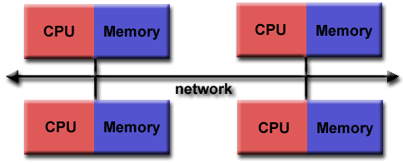
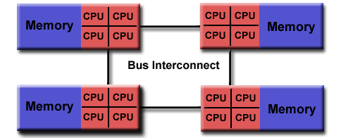
1 内存一致性
1.1 Introduction
Parallel Programming Paradigms
Message Passing
Distributed
Send + onReceive
Shared Memory
Concurrent
Write + Read

Slide 3
1 内存一致性
1.1 Introduction
A Simple Example
Consider the following codes:
What are the possible outcomes?
P1
A = 0, B = 0, C = 0;
C = 1;
A = 1;
P2
while (A == 0);
B = 1;
P3
while (B == 0);
print A, C;
Initialization
Parallel
A==1, C==1? | Yes, as is expected;
A==0, C==1? A==0, C==0? A==1, C==0? | Yes, for P2 may see P1’s writes in advance;

Slide 4
1 内存一致性
1.1 Introduction
A Simple Example
Consider the following codes:
What are the possible outcomes?
Who THE HELL can tell us when values can be SEEN?
Memory Consistency
P1
A = 0, B = 0, C = 0;
C = 1;
A = 1;
P2
while (A == 0);
B = 1;
P3
while (B == 0);
print A, C;
Initialization
Parallel

Slide 5
1 内存一致性
1.1 Introduction
Terminology
Memory Consistency Model
The policy that places an early and late bound on when a new value can be propagated to any given processor;
Cache Coherence Protocol
The mechanism that propagates a newly written value to the cached copies of the modified location;
Exactly the same? Nope!

Slide 6
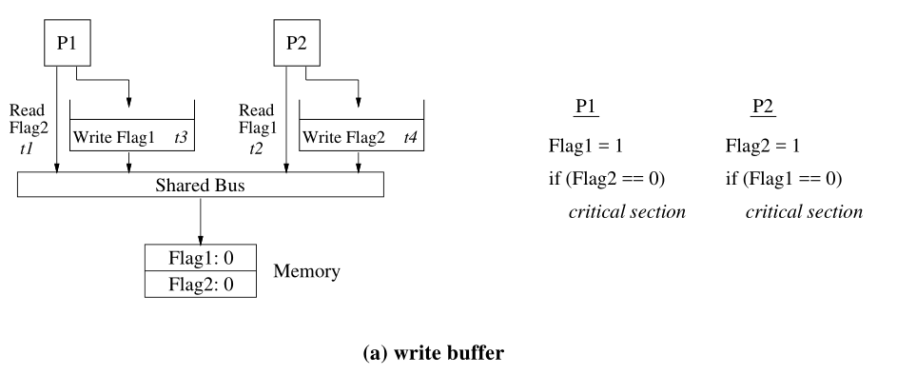
1 内存一致性
1.1 Introduction
Terminology
There DO exist architectures, though DON’T have cache, are also threatened with consistent problems.

Slide 7
1 内存一致性
1.2 Sequential Consistency
The Definition
[A multiprocessor system is sequentially consistent if] the result of any execution is the same as if the operations of all the processors were executed in some sequential order, and the operations of each individual processor appear in this sequence in the order specified by its program.
Key word: program order, atomicity;

Slide 8
1 内存一致性
1.2 Sequential Consistency
The Definition
[A multiprocessor system is sequentially consistent if] the result of any execution is the same as if the operations of all the processors were executed in some sequential order, and the operations of each individual processor appear in this sequence in the order specified by its program.
Key word: program order, atomicity;
Initially Flag1 = Flag2 = 0
P1
Flag1 = 1
if (Flag2 == 0)
critical section
P2
Flag2 = 1
if (Flag1 == 0)
critical section

Slide 9
1 内存一致性
1.2 Sequential Consistency
The Definition
[A multiprocessor system is sequentially consistent if] the result of any execution is the same as if the operations of all the processors were executed in some sequential order, and the operations of each individual processor appear in this sequence in the order specified by its program.
Key word: program order, atomicity;
Initially A = B = 0
P1
A = 1
P2
If(A == 1)
B = 1
P3
If(B == 1)
register1 = A

Slide 10
1 内存一致性
1.2 Sequential Consistency
The Cons
Uniprocessor compiler optimization that can result in reordering memory operations are restricted, e.g.
Simple optimizations:
Code motion;
Register allocation;
Common sub-expression elimination;
...
Sophisticated optimizations:
Loop blocking;
Software pipelining;
...
Compilers etc. : Mewww ?!

Slide 11
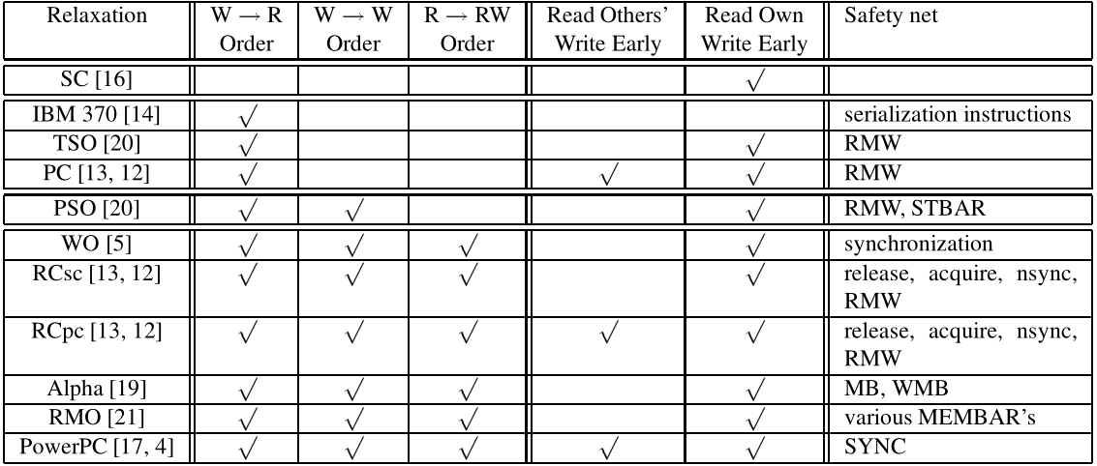
1 内存一致性
1.3 Relaxed Consistency
(Ancient) Commercial System Layout
Simple categorization of relaxed models

Slide 12
1 内存一致性
1.3 Relaxed Consistency
TSO
[Operations that write to memory have a total (store) order if] all processors agree on their order of execution.
How does it relax program order:
[√] W→R Order
[x] W→W Order
[x] R→RW Order
How does it relax write atomicity:
[x] Read Others’ Write Early
[x] Read Own Write Early
Safety net: RMW, membar
Note: →: Happened-before relation; W: Write; R: Read;

Slide 13
1 内存一致性
1.3 Relaxed Consistency
TSO
Processor 0 | Processor 1
mov [_x], 1 // M1 mov r1, [_y] // M2 | mov [_y], 1 // M3 mov r2, [_x] // M4
Initially x == y == 0 r1 == 0 and r2 == 0 is allowed
Program Order: [√] W→R Order
Note: We use M1, M2 etc. to number the instructions in the examples. Stores are written as mov [_x], val which implies that val is being stored into the memory location x. Loads are written as mov r, [_x] which implies that the contents of the memory location x are being loaded into the register r.

Slide 14
1 内存一致性
1.3 Relaxed Consistency
TSO
Processor 0 | Processor 1
mov [_x], 1 // M1 mov [_y], 1 // M2 | mov r1,[_y] // M3 mov r2, [_x] // M4
Initially x == y == 0 r1 == 1 and r2 == 0 is not allowed
Program Order: [x] W→W Order; [x] R→RW Order
Note: We use M1, M2 etc. to number the instructions in the examples. Stores are written as mov [_x], val which implies that val is being stored into the memory location x. Loads are written as mov r, [_x] which implies that the contents of the memory location x are being loaded into the register r.

Slide 15
1 内存一致性
1.3 Relaxed Consistency
TSO
Processor 0 | Processor 1 | Processor 2 | Processor 3
mov [_x], 1 // M1 | mov [_x], 2 // M2 | mov r1, [_x] // M3 mov r2, [_x] // M4 | mov r3, [_x] // M5 mov r4, [_x] // M6
Initially x == 0 r1 == 1, r2 == 2, r3 == 2, r4 == 1 is not allowed
Atomicity: [x] Read Others’ Wirte Early
Note: We use M1, M2 etc. to number the instructions in the examples. Stores are written as mov [_x], val which implies that val is being stored into the memory location x. Loads are written as mov r, [_x] which implies that the contents of the memory location x are being loaded into the register r.

Slide 16
1 内存一致性
1.3 Relaxed Consistency
TSO
Processor 0 | Processor 1 | Processor 2
mov [ _x], 1 // M1 | mov r1, [ _x] // M2 mov [ _y], 1 // M3 | mov r2, [ _y] // M4 mov r3, [ _x] // M5
Initially x == y == 0 r1 == 1, r2 == 1, r3 == 0 is not allowed
Atomicity: Stores are transitively visible
Note: We use M1, M2 etc. to number the instructions in the examples. Stores are written as mov [_x], val which implies that val is being stored into the memory location x. Loads are written as mov r, [_x] which implies that the contents of the memory location x are being loaded into the register r.

Slide 17
1 内存一致性
1.3 Relaxed Consistency
TSO
Processor 0 | Processor 1
mov [ _x], 1 // M1 mov r1, [ _x] // M2 mov r2, [ _y] // M3 | mov [ _y], 1 // M4 mov r3, [ _y] // M5 mov r4, [ _x] // M6
Initially x == y == 0 r2 == 0 and r4 == 0 is allowed
Atomicity: Read Own Write Early
Note: We use M1, M2 etc. to number the instructions in the examples. Stores are written as mov [_x], val which implies that val is being stored into the memory location x. Loads are written as mov r, [_x] which implies that the contents of the memory location x are being loaded into the register r.

Slide 18
1 内存一致性
1.3 Relaxed Consistency
TSO
Safety net: Mechanisms provided for programmers for overriding relaxations.
[Program order appears to be maintained if] either the write or the read is already part of a read-modify-write(RMW) or is replaced by a read-modify-write.
What is a RMW?
ie. locked instructions in intel 64 architecture, including the implicitly locked xchg instruction and other read-modify-write instructions with a lock prefix.

Slide 19
1 内存一致性
1.3 Relaxed Consistency
TSO
Safety net: Mechanisms provided for programmers for overriding relaxations.
For TSO, program order appears to be maintained if either the write or the read is already part of a read-modify-write(RMW) or is replaced by a read-modify-write.
What is a RMW?
How to replace a read/write with RMW?
Read: the write in the read-modify-write must be a “dummy” write that writes back the read value;
Write: writing back the desired value regardless of what the read returns.

Slide 20
1 内存一致性
1.3 Relaxed Consistency
TSO
Safety net: Mechanisms provided for programmers for overriding relaxations.
For TSO, program order appears to be maintained if either the write or the read is already part of a read-modify-write(RMW) or is replaced by a read-modify-write.
Memory barrier, also known as a membar, memory fence or fence instruction, is a type of barrier instruction that causes a CPU or compiler to enforce an ordering constraint on memory operations issued before and after the barrier instruction. (From wiki)
eg. MFENCE guarantees that every load and store instruction that precedes the MFENCE instruction in program order becomes globally visible before any load or store instruction that follows the MFENCE instruction.

Slide 21
1 内存持久性
2.1 Terminology
The Definition of Memory Persistency
Memory persistency is an extension of consistency models for persistent memory operations.
Memory persistency prescribes the order of persist operations with respect to one another and loads and stores, and allows the programmer to reason about guarantees on the ordering of persists with respect to system failures;

Slide 22
1 内存持久性
2.1 Terminology
If you mind..
Store: The cache coherence actions required to make a write (including an NVRAM write) visible to other processors;
Persist: The action of writing durably to NVRAM.
Persist Atomicity: persists to each address are serialized, implying that recovery determines a unique value for each address;
Recovery Observer: A virtual processor that atomically reads all of persistent memory at the moment of failure;
Propagation of Store
Propagation of Persist
P1
……
Pn
RO

Slide 23
1 内存持久性
2.1 Strict Persistency
The Definition of Strict Persistency
Under strict persistency, persist order observes all happens-before relations(denoted: →) implied by volatile memory order;

Slide 24
1 内存持久性
2.1 Strict Persistency
The Definition of Strict Persistency
Under strict persistency, persist order observes all happens-before relations(denoted: →) implied by volatile memory order;
Optimization: Buffered strict persistency
Buffered strict persistency allows instruction execution to proceed ahead of persistent state, thus allowing overlap of volatile execution and serial draining of queued persist operations;
Propagation of Store
Propagation of Persist
P1
……
Pn
RO
Persistent Queue

Slide 25
1 内存持久性
2.2 Epoch Persistency
The Definition of Epoch Persistency
Under epoch persistency, each thread’s execution is additionally separated into persist epochs by persist barrier instructions, persists within each epoch are concurrent and may reorder or occur in parallel;
lock (volatile mutex)
persist Qe.data[0] = x
persist Qe.data[1] = y
persist Qe.valid = true
unlock
D[0]
lock (volatile mutex)
persist Qe.data[0] = x
persist Qe.data[1] = y
persist barrier
persist Qe.valid = true
unlock
Epoch 1
D[0]
D[1]
D[1]
Epoch 2
V
V
strict persistency
epoch persistency

Slide 26
1 内存持久性
2.2 Epoch Persistency
The History of Epoch Persistency
Epoch persistency is similar to BPFS, but additionally allows persists to addresses protected by a lock to reorder with respect to the lock operations.
Pros: May avoid delaying the lock release while the persist completes;
Persist A
Persist A
VM Code
VM Code
Persist B
Persist B
Lock
Persist Barrier
Persist Barrier
BPFS’s Epoch
New Epoch

Slide 27
1 内存持久性
2.2 Epoch Persistency
The History of Epoch Persistency
Epoch persistency is similar to BPFS, but additionally allows persists to addresses protected by a lock to reorder with respect to the lock operations.
Cons: Reasoning about persist order across threads can be challenging.
Persist A
Persist A
VM Code
VM Code
Persist B
Persist B
Lock
Unlock
IDEAL
REAL

Slide 28
1 内存持久性
2.2 Epoch Persistency
The History of Epoch Persistency
Epoch persistency is similar to BPFS, but additionally allows persists to addresses protected by a lock to reorder with respect to the lock operations.
Cons: Reasoning about persist order across threads can be challenging.
Solution: Preceding and following all persists with a persist barrier.

Slide 29
1 内存持久性
2.2 Epoch Persistency
A Drawback of Epoch Persistency
May incur extra constraints
persist A
persist B
persist C
persist A
persist barrier
persist B
persist C
persist A
persist barrier
persist C
persist B
persist A
persist barrier
persist B
persist C
persist A
persist barrier
persist C
persist B
A
A
A
C
C
C
B
B
B
IDEAL
DAG-1
DAG-2

Slide 30
1 内存持久性
2.3 Strand Persistency
The Definition of Strand Persistency
A strand is an interval of memory execution from a single thread separated by strand barrier instructions.
Accesses from different strands, even from the same thread, are concurrent unless ordered by strong persist atomicity;
persist A
persist barrier
persist B
newStrand
persist C
A
C
B
Strand Persistency that Express Minimal Constraints

Slide 31
References
[1]: S. Adve and K. Gharachorloo. Shared memory consistency models: a tutorial. Computer, 29(12):66–76, 1996.
[2]: Intel Corporation. Intel 64 Architecture Memory Ordering White Paper, Aug 2007.
[3]: Guide P. Intel® 64 and IA-32 Architectures Software Developer’s Manual[B]. Volume 3B: System programming Guide, 2011.
[4]: Pelley S, Chen P M, Wenisch T F. Memory persistency[C]// Proceeding of the International Symposium on Computer Architecture (ISCA’14). ACM, 2014:265-276.

